Slide 1
DALON5 Interim Project
Visualisation & Insights
Of Adventure Works™
Ruzzel Pescozo
Charles Clarke
Basil Wahid
Sava Drobot
Silk Somalin
Instructor: Griffin John Maree

Slide 2
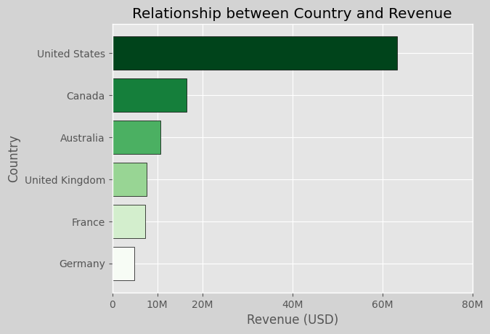
Q3. What is the relationship between Country and Revenue
United states is the highest performer in revenue while Germany is the lowest
This could be due to many variables. Maybe stores?

Slide 3
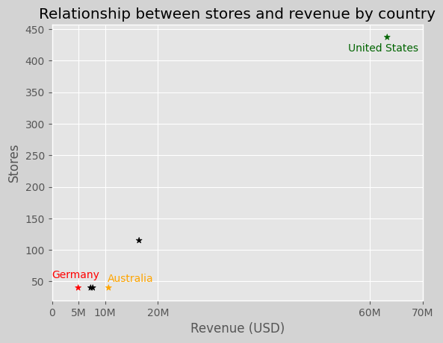
Q3. What is the relationship between Country and Revenue
We can clearly see that US which has the most stores also has the highest revenue
Whereas Germany has the least stores and thus the least revenue
Australia has similar stores to germany but double the revenue this suggests that there is a gap in the market, meaning opening more stores there is better
why does US have so much revenue?

Slide 4
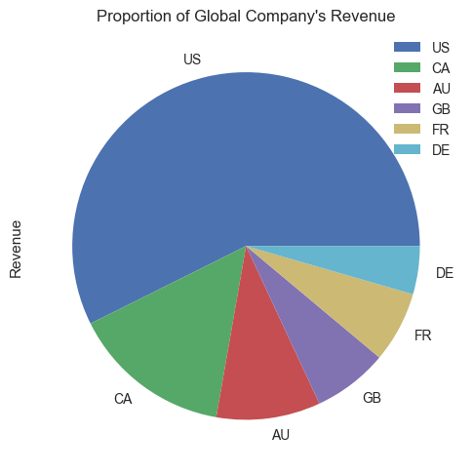
Q1. What is the regional sales in the best performing country?
1.1 What is the best performing country?
Here we can see that the United States of America (US), dominates the proportion of Adventure Works™ revenue.
The US market accounts for approximately 57% of revenue.
North American continent is the predominant market, with Canada 2nd largest contributor to AW’s revenue.

Slide 5
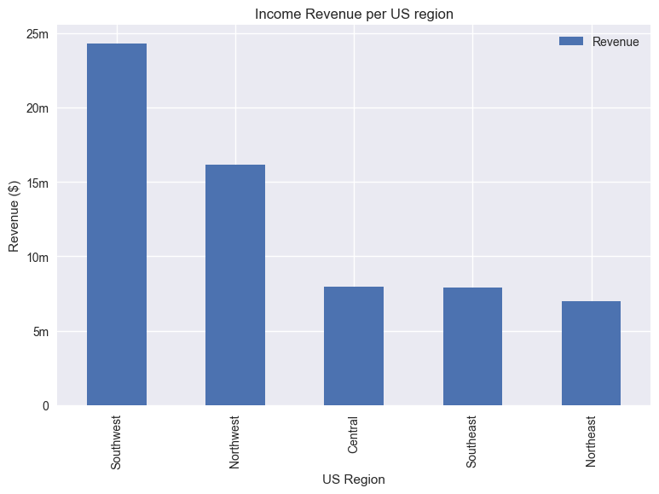
Q1. What is the regional sales in the best performing country?
1.2 Sales in the US regions
The Southwest and Northwest regions have notably higher revenues coming in, in comparison to the other 3 regions.

Slide 6
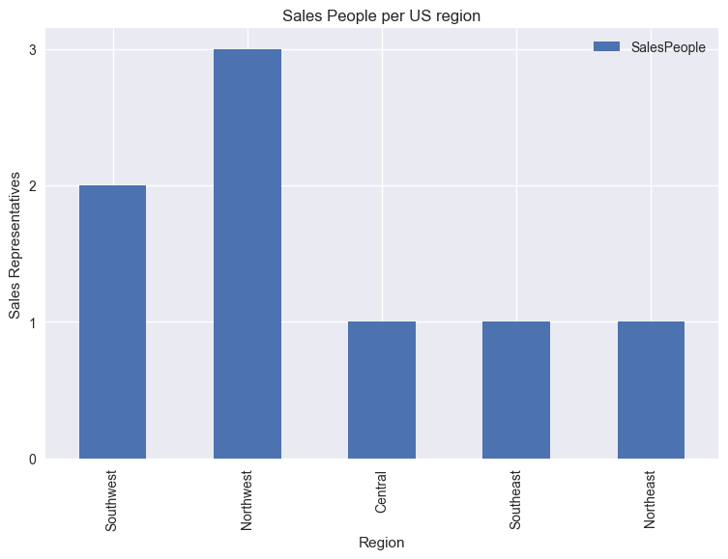
Q1. What is the regional sales in the best performing country?
1.3 Is this the result of salespeople?
The Southwestern team is smaller than Northwestern, yet selling more.
We should look at effectiveness of each salesperson within each territory.

Slide 7
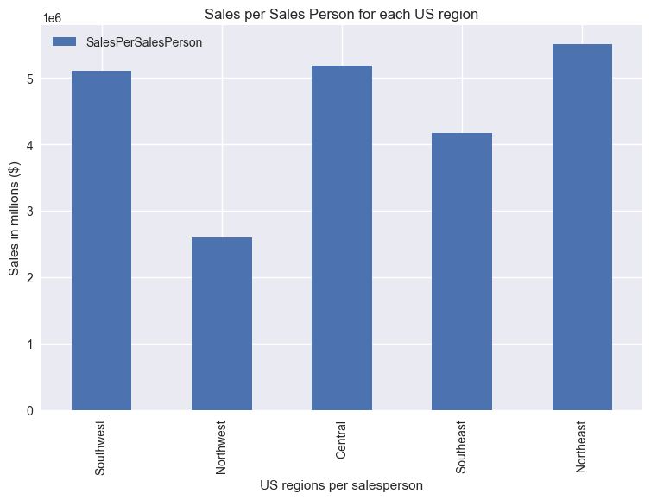
Q1. What is the regional sales in the best performing country?
1.3 Is this the result of salespeople?
I therefore questioned whether revenues are higher as a result of a greater sales team. This tells us that the sales per salesperson is actually lowest in the Northwest region. Ultimately, the data isn’t reliable to assume a relationship, due to the small nature of the Adventure Works’ sales teams size.

Slide 8
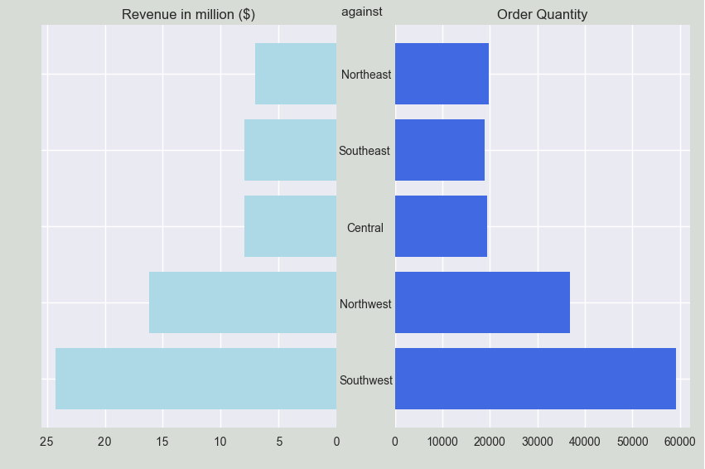
Q1. What is the regional sales in the best performing country?
1.4 Is this the result of order quantity?
Southwest is leading in order quantity and income revenue.
Furthermore, the mirrored shape shows the clear relationship between the two variables

Slide 9
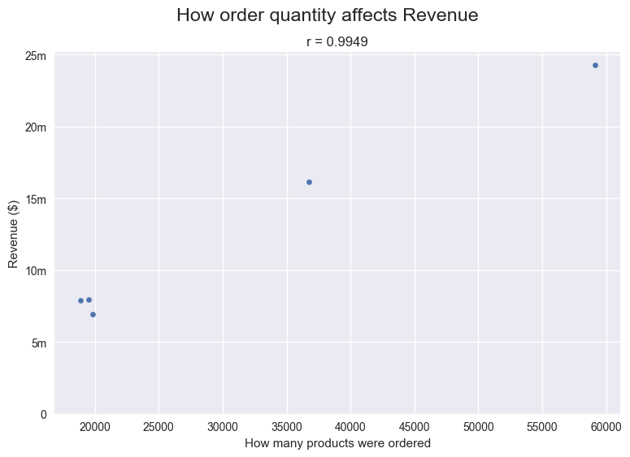
Q1. What is the regional sales in the best performing country?
1.4 Is this the result of order quantity?
There is a strong, positive correlation between the quantity ordered and income revenue.
However, few data points may limit the reliability of data.

Slide 10
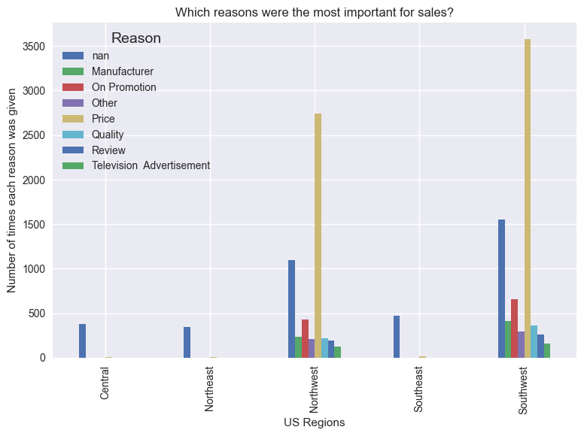
Q1. What is the regional sales in the best performing country?
1.5 What are the leading reasons for purchasing Adventure Works™ products
Here we can see a relatively low data inputs for reason of purchase in the Central, Northeast and Southeast regions.
We will therefore filter these factors out.

Slide 11
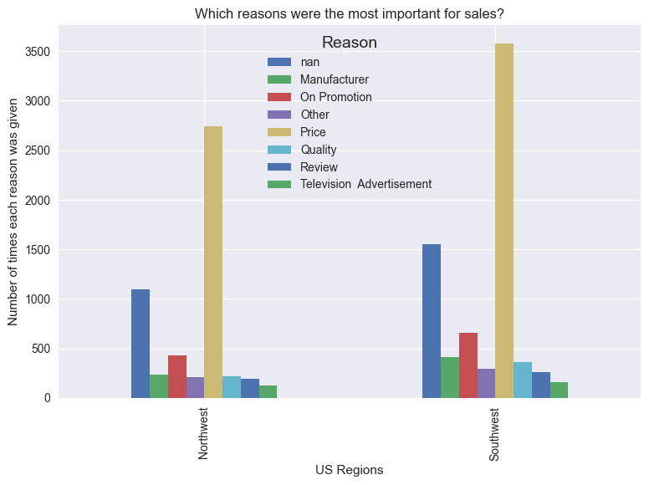
Q1. What is the regional sales in the best performing country?
1.5 What are the leading reasons for purchasing Adventure Works™ products
This has resulted in our graph on the right, illustrating a similar pattern for both regions.
Price is the outright leading reason for purchase in both regions, with promotion second.
Reviews and quality amongst the lowest.

Slide 12
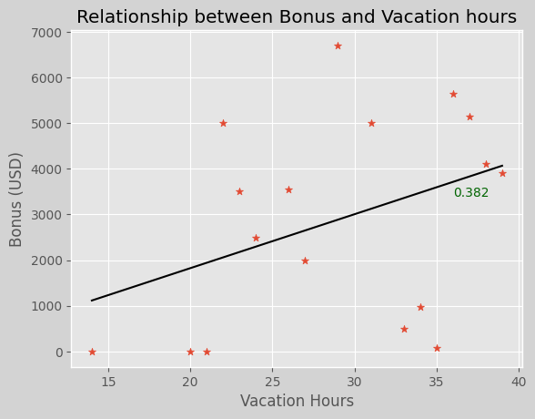
Q2. What is the relationship between annual leave taken and bonus?
A moderately positive correlation is observed suggesting as bonuses rise so do vacation hours, this could be due to the fact that as people have more disposable income they can take more vacation hours instead of just saving them.
As there are some values of bonus being 0 due to the entities being managers we include these as maybe the managers did not receive a bonus this year
What affects vacation hours? Could other variables cause vacation hours to rise?

Slide 13
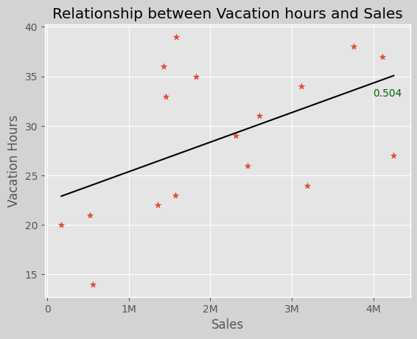
Q2. What is the relationship between annual leave taken and bonus?
Vacation hours and sales?
Again a moderate positive correlation is seen, this could be due to the fact that as more sales are made the person is seen more seniorly thus allowed more vacation days? However everyone had the same job title so this could be weak
However again, very small sample size thus hard to conclude this
Could sales affect bonus?

Slide 14
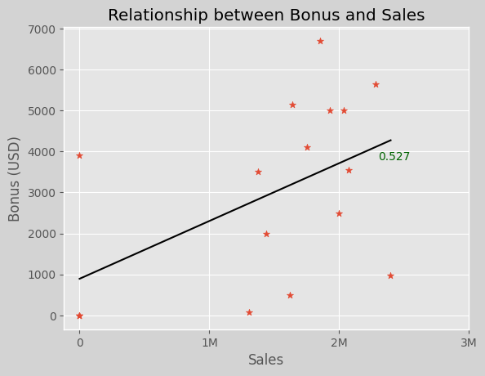
Q2. What is the relationship between annual leave taken and bonus?
Sales and bonus?
Moderate positive correlation shown again, suggesting higher sales mean higher bonus
However again, sample size too small to conclude
Could higher bonus due to sales be caused by higher commission percentage?

Slide 15
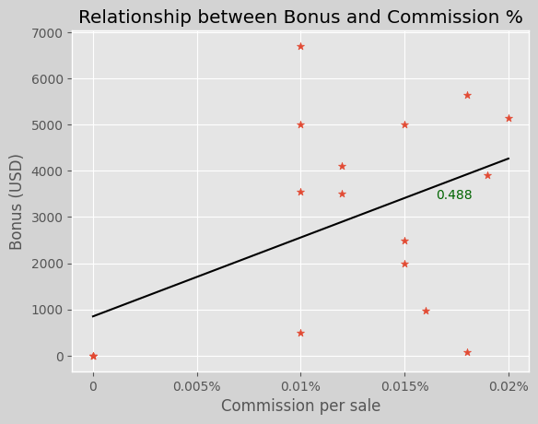
Q2. What is the relationship between annual leave taken and bonus?
Bonus and Commission?
Moderate correlation yet again! This expected as higher sales commission would mean a higher bonus
A 0.488 Correlation coefficient suggests moderate correlation but a 0.6+ would suggest a strong relation

Slide 16
Q2. What is the relationship between annual leave taken and bonus?
Conclusion:
It is evident that there is some positive relationship between bonus and annual leave hours, However, the degree to this is weak and couple that with the small sample size you cannot clearly conclude this. There are many other factors like; job title, seniority, different departments, However due to the limited data we cannot be 100% sure and would need to gather more data.

Slide 17
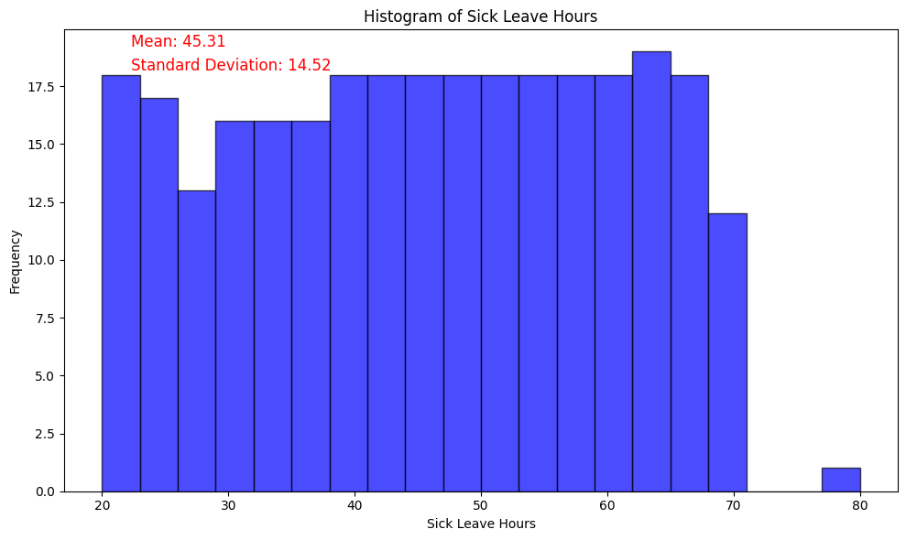
Q4 What is relationship between Sick Leave Hours and Job Title?
We can observe a uniform distribution. This means that, for every job title, there is an equal likelihood of having any sick leave hours between 20 and 70, with a slight gap at around 25.

Slide 18
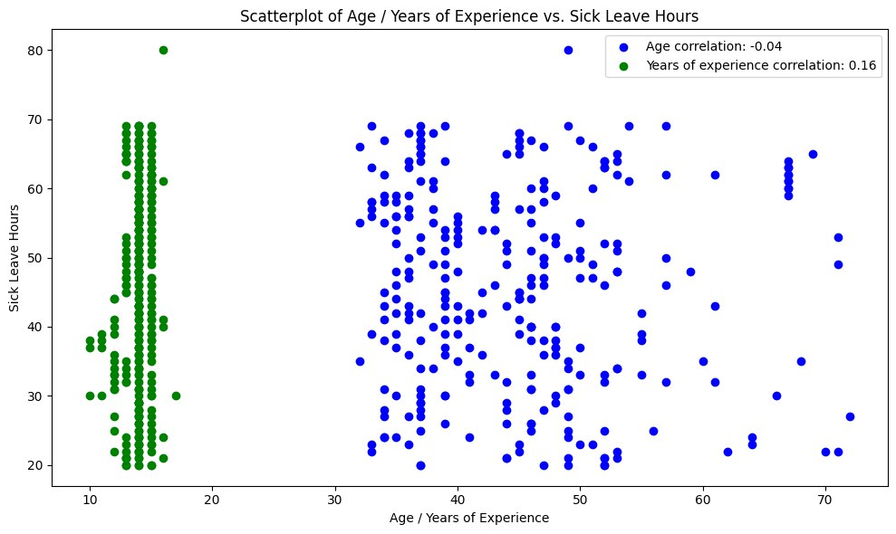
There are 55 unique Job Titles. Could age or years of experience play a greater role?
We can see that there is no correlation between age or years of experience in the company with sick leave hours.

Slide 19
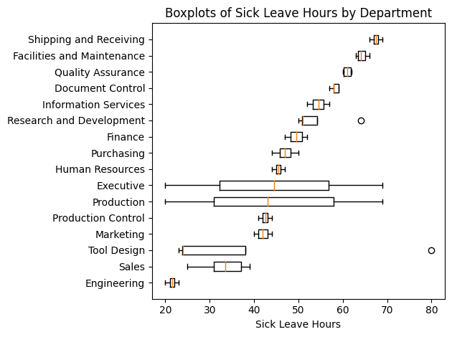
Let’s have a look on departments
Sick leave hours depends on the department. In the following graph we can observe that ‘Shipping and Receiving’, ‘Facilities and Maintenance’, ‘Quality Assurance’ have the most Sick leave hours, while ‘Engineering’ has the lowest.

Slide 20
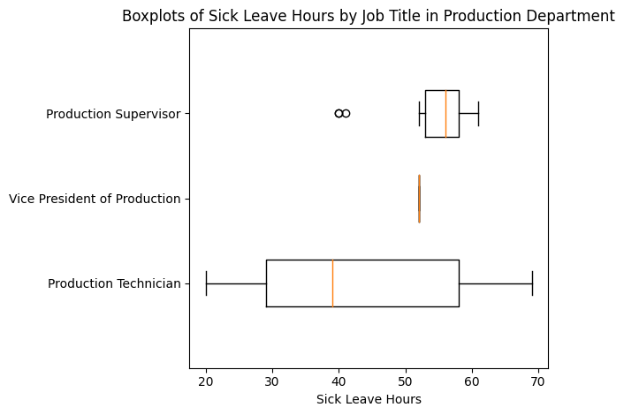
Why Production department has wide distribution?
The wide distribution of Production Department is because of wide distribution of ‘Product Technician’. Distribution of Sick leave Hours for Product Technician is very similar to the distribution of the whole data set.

Slide 21
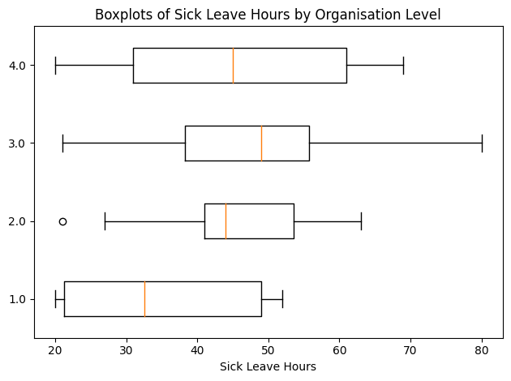
Does sick leave hours depend on organisation level?
First organisation level is top management. So the higher the position, the more responsibility, the less likely that an employee would take a sick leave with minor disease. Based on the graph first and second organisation level job titles has less sick leave hours than whole distribution while third and forth is as wide as whole data set.

Slide 22
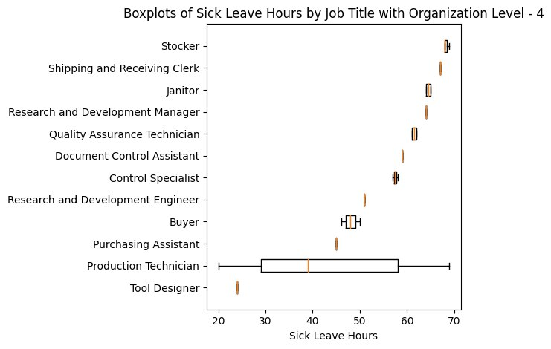
Job Titles with organisation level - 4
We can see that Tool Designers are taking less sick leave hours compared to other employees at the same organisation level. And wide distribution of Production Technician blurs the picture of Sick leave hours based on organisation level.

Slide 23
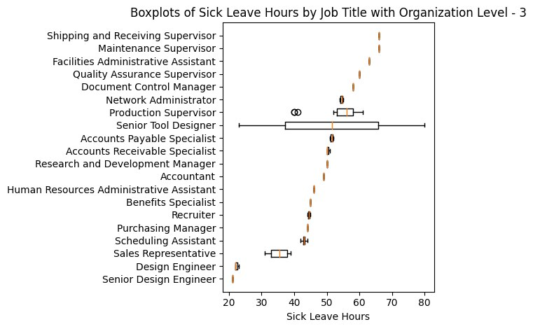
Job Titles with organisation level - 3
We can see that Design Engineer, Senior Design Engineer and Sales Representative are taking less sick leave hours compared to other employees at the same organisation level.

Slide 24
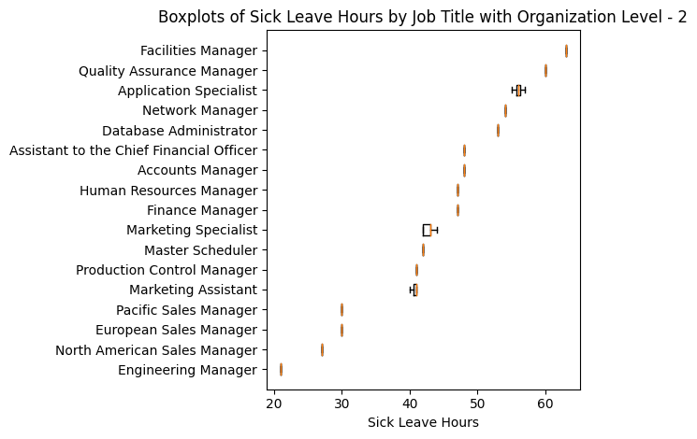
Job Titles with organisation level - 2
We can see that Pacific, European and North American Sales Managers, as well as the Engineering Manager are taking less sick leave hours compared to other employees at the same organisation level.

Slide 25
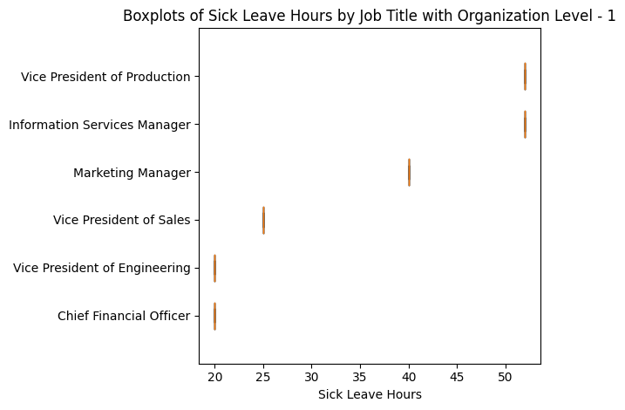
Job Titles with organisation level - 1
Taking into account the CEO’s 69 sick leave hours, it suggests that top executives may either strive to minimize their sick leave hours or, conversely, take more sick leave hours, possibly due to various factors.

Slide 26
Conclusion
Sick leave hours(SLH) doesn’t depend on age or years of experience within company
SLH depends on organisation level, department and Job Title
SLH vary significantly by department, with ‘Shipping and Receiving’, ‘Facilities and Maintenance’, ‘Quality Assurance’ departments recording the highest sick leave hours, while the ‘Engineering’ department reports the lowest.
SLH of Production Technician and Senior Tool Designer haven’t been affected by Job Title.
Certain job titles, including Tool Designers, Design Engineers, Senior Design Engineers, Sales Representatives, Regional Sales Managers, and Engineering Manager, have been found to exhibit lower SLH compared to their counterparts within the same organisation level.
Top executives may either strive to minimize their SLH or, conversely, take more SLH

Slide 27
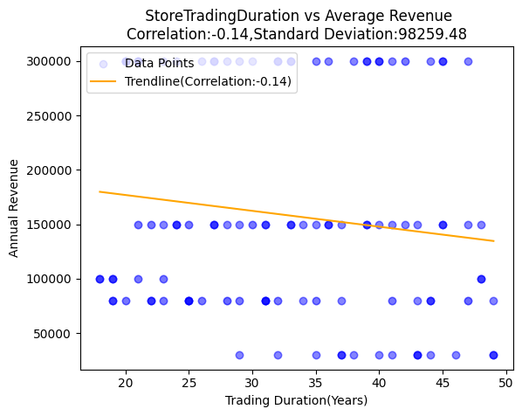
Q5 .What is the relationship between Store trading duration and revenue?
The Store Trading Duration is the measure taken from the number of years a store is opened till 2019.
After we calculated we will find the relationship with Annual Revenue
Findings: It shows slightly weak correlation with positive standard deviation let's find out the Factors affecting this weak relationship

Slide 28
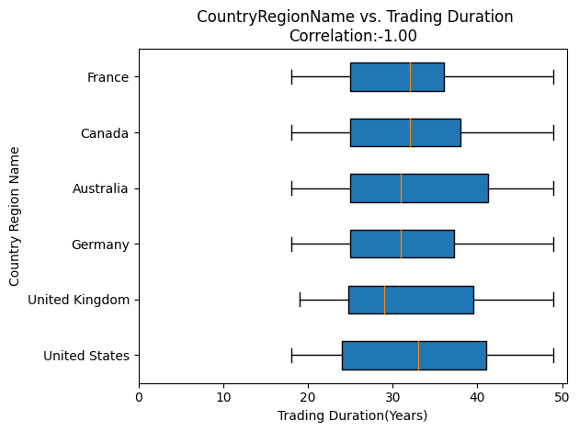
CountryRegionName and Trading Duration
Weak correlation Indicates with an increase in Trading Duration, Revenue decreases .so one of the major factors affecting can be country’s economic conditions. Lets compare with Trading duration with individual countries countries
Findings: Countries like US and AUSTRALIA have more variable data but still as we see weak relationship that means longer Trading duration is affected by store location

Slide 29
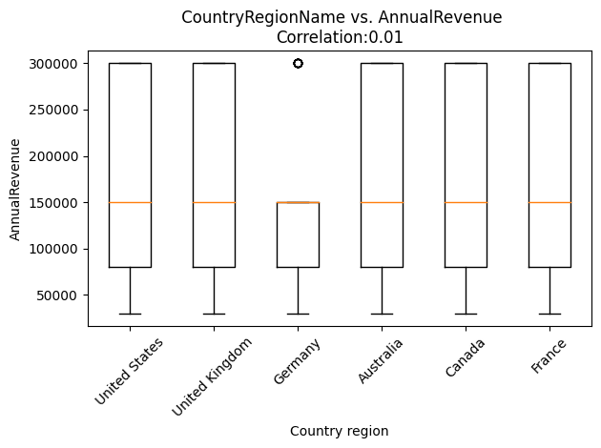
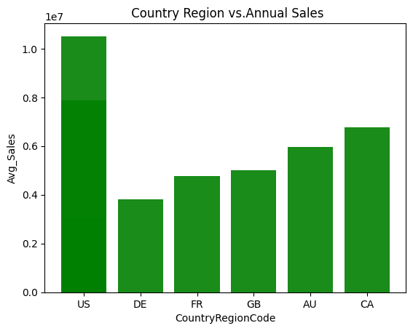
CountryRegionName vs Annual Revenue
CountryRegionCode vs Average Sales
Here we can see no correlation between country region and annual revenue because most countries have very similar performance
As sales plays a vital role in increase in Revenue so we compared the average sales with the individual countrie. As we can see here, US,CANADA AUSTRALIA have higher sales which contribute to high revenue

Slide 30
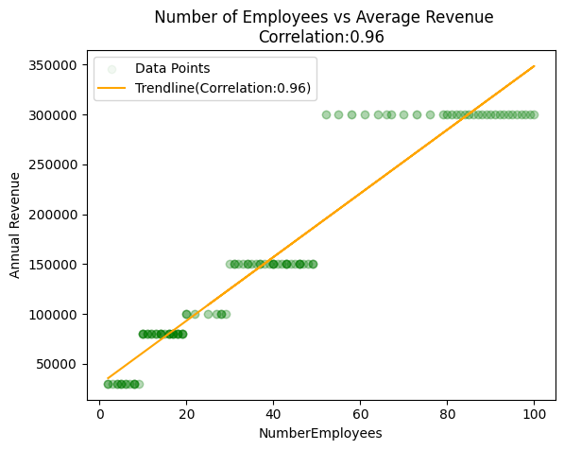
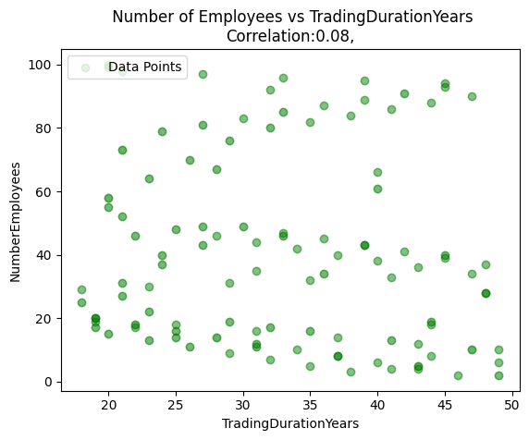
Number of Employee and Revenue
It shows positive relation which indicate good economic growth with greater customer satisfaction and skilled workforce ,increase in job hiring while increase in revenue
There is basically little or no relationship between the number of employees and Trading Duration so this shows the

Slide 31
CONCLUSION
Even though we saw weak relation between Annual Revenue and Trading duration but we found some countries have good revenue and good sales record that shows some store opened for longer duration but still they might not be been adapted to evolving customer needs or trends or still follow outdated business models which hinder revenue growth so some long duration trading business needs to adapt to new technological advancement,regulatory changes or economic shifts to attract new customers and generate higher revenue

Slide 32
Q6 - What is the relationship between the size of stores, number of employees and revenue?
Goal: Find the Relationship between the 3 datasets & to observe and find a potential relation that may increase/maximize revenue

Slide 33
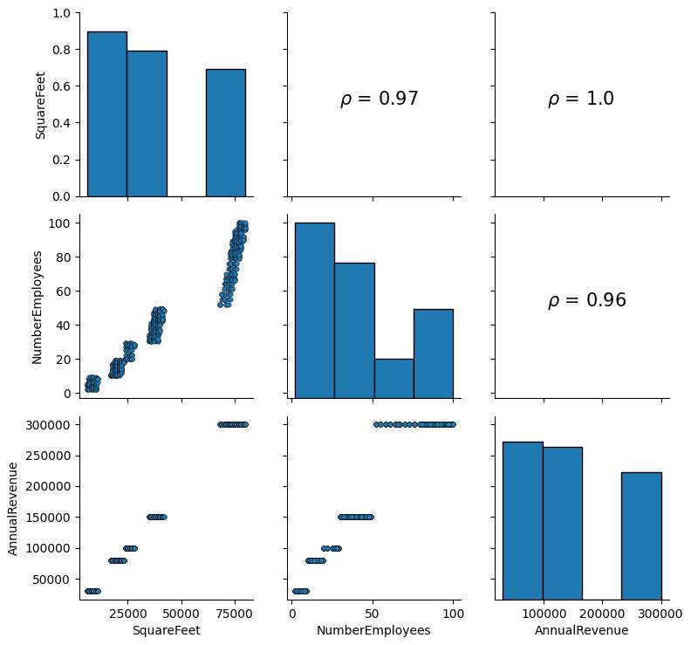
Q6 - Initial Relation Insights
Data of all 701 Stores in DB
All distributions are slightly positively skewed
All pairs of relations have a strong positive correlation
Larger Stores have a higher likelihood of having more employees
More Employees + Larger Stores = More Revenue?

Slide 34
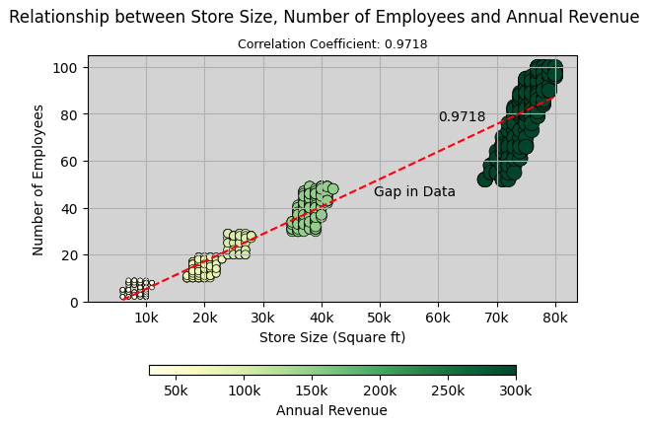
Q6 - Combined Relational Insight between all 3 Factors
More Green = More Revenue
Revenue is clustered in groups
More Employees + Larger Stores = More Revenue
(directly proportional)

Slide 35
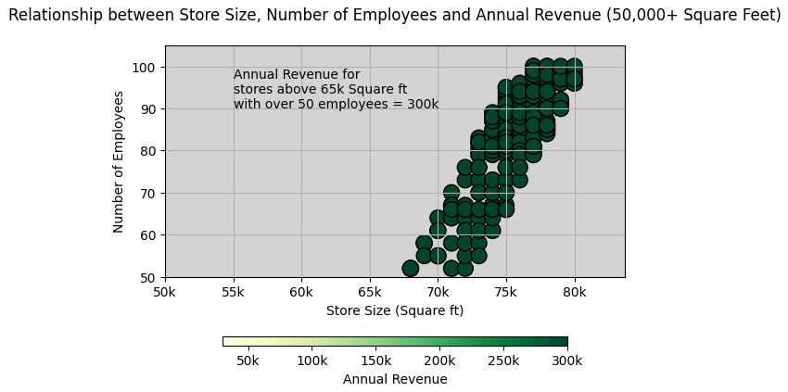
Q6 - Concluding Insight
Part 1 Maximize Revenue
Sweet spot for Max Revenue
Increasing Store size and Number of Employees further does not affect Revenue
Utilizing Larger Stores with an efficient number of employees for Max potential Revenue
Cost Efficient Ratio using Scatterplot:
Store Size = 65k-75k Square ft Number of Employees = 50-60 people

Slide 36
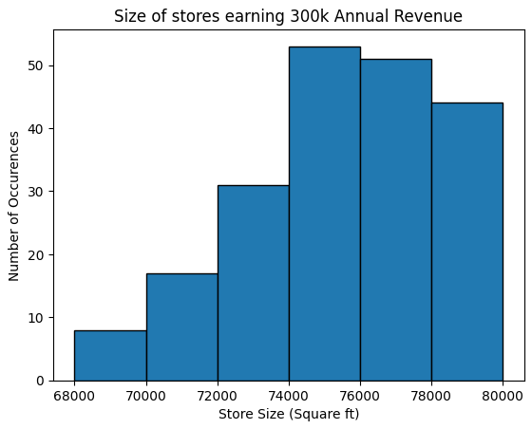
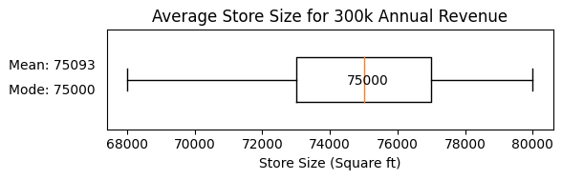
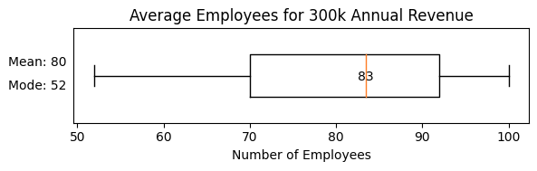
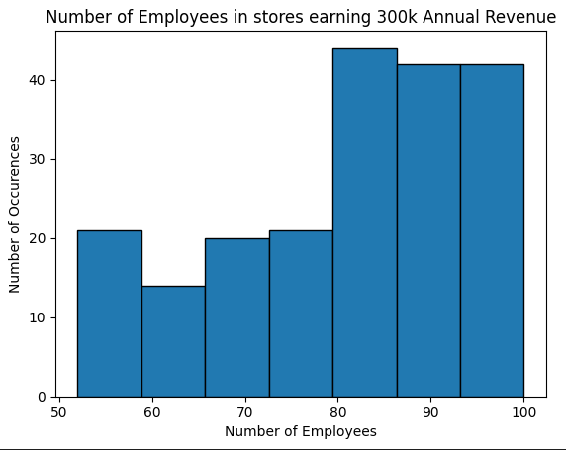
Q6 - Concluding insight Part 2 - More Reliable Options
Negative Skew
Reliable Store Size: 75,000 Sq Ft
Reliable Number of Employees: 80
Keep stores that are smaller than 75,000k Sq Ft in size and stores that have less than 80 employees

Slide 37
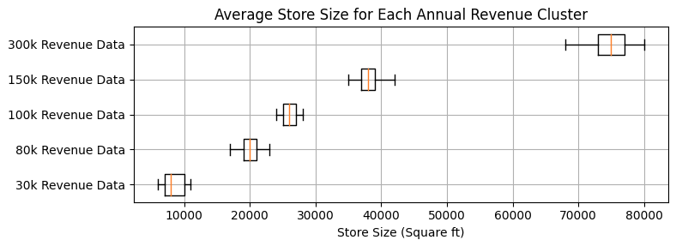
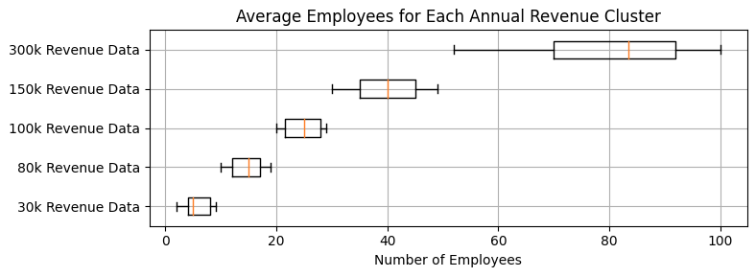
Q6 - Preview of more Insight, maximise every store

Slide 38
Thank you for listening
Extra visualizations & Insights
are available in Python Code
for extra information

